Slide 1

MODELING AND ANALYSIS OF IEEE 13 BUS UNBALANCED DISTRIBUTION SYSTEM USING OPENDSS
TEAM MEMBERS:
DINESH GOVIND G C
AKASH S
ADHITYA A V
GUIDED BY:
Sr. Asst. Professor
Dr. KARTHIKAIKANNAN D

Slide 2

ABSTRACT
In this work we analyze and compare the p.u. voltage profile, P and Q - power losses of elements connected in system and the power flow between the buses and transformers in the IEEE 13-Bus distribution system by taking both the IEEE standard benchmark data and the system with the addition of loads and capacitors. Here we map how the per phase P.U voltages , power loss change after the alteration in the existing system elements.

Slide 3
AIM
The main goal of this work to analyze how P.U Voltage balances and power loss reduces with the addition of loads and capacitors to the existing standard load flow data of IEEE 13 Bus Distribution System. We add compensation capacitors and realistic loads to make the system - balanced, efficient if there is a possibility of inclusion of new loads under real rural domestic conditions.

Slide 4
LITERATURE REVIEW
REFERENCE | SOURCE | INFERENCE
IEEE13 – Bus Analysis in OpenDSS with PV System and Storage – IEEE Xplore | IEEE XPLORE https://ieeexplore.ieee.org/document/1129592/ | Addition of PV reduced voltage drop across the feeder but increased phase imbalance. Large loads shift voltages up or down depending on demand–generation present on the particular bus. Distributed Energy sources provided voltage support but the unbalancing was still present.
Unbalanced Distribution Power Flow with Distributed Generation Sarika Khushalani, Student Member, IEEE, and Noel Schulz, Senior Member, IEEE –RESEARCH GATE | RESEARCH GATE https://www.researchgate.net/publication/224643624_Unbalanced_Distribution_Power_Flow_with_Distributed_Generation | This paper works on matching the calculated data with the specified data of standard test case data (with and without DG integration) and cross-checking results using RDAP-Radial Distribution Analysis Package used for load flow analysis
Impact Assessment of PV Penetration on Unbalanced Distribution network with Dynamic load condition-IEEE Xplore | IEEE XPLORE https://ieeexplore.ieee.org/document/9726552/ | Optimal Placement and sizing of PV (100KW at Bus 675) improved positive sequence voltage profiles and reduced line losses compared without PV, while maintaining system parameters within ( ANSI ) permissible limits.

Slide 5
OBJECTIVES
PROBLEM FORMULATION
Maintaining stable voltage and minimizing losses in power distribution systems is difficult due to unbalanced and varying loads. This project uses the IEEE 13-bus system in OpenDSS with 24-hour load variation to analyze voltage, current, and losses, aiming to ensure efficient and reliable operation.
To perform load flow analysis of the distribution system and obtain the voltage profile (p.u) and power losses occurred in transformers and buses.
To understand on how the system parameters of the feeder change with the addition of loads.
Including the compensation capacitors to improve the voltage p.u and reduce the losses.

Slide 6
METHODOLOGY
IEEE 13-BUS DISTRIBUTION SYSTEM STUDY
Selection of Test System
Standard IEEE 13-bus distribution system chosen as the base model.
Model Development
System was modeled with predefined parameters like line data, transformers, loads, and capacitors.
Load Flow Analysis
Initial load flow performed using those data to observe voltage profile and system losses.
Modification of System Parameters
Additional loads(rural loads) introduced; line codes and distributed loads modified to study behavior under increased loading.
Simulation Setup(Incorporation of Load Shapes)
Performance Monitoring
Key parameters monitored: voltage, current, power and losses.
Result Analysis
Results analyzed to understand impact of load variation on voltage profile, feeder performance, and system losses.
24-hour load shape applied to analyze time-varying load behavior.
Daily simulation carried out with 1-hour time step to evaluate system performance over 24 hours.

Slide 7
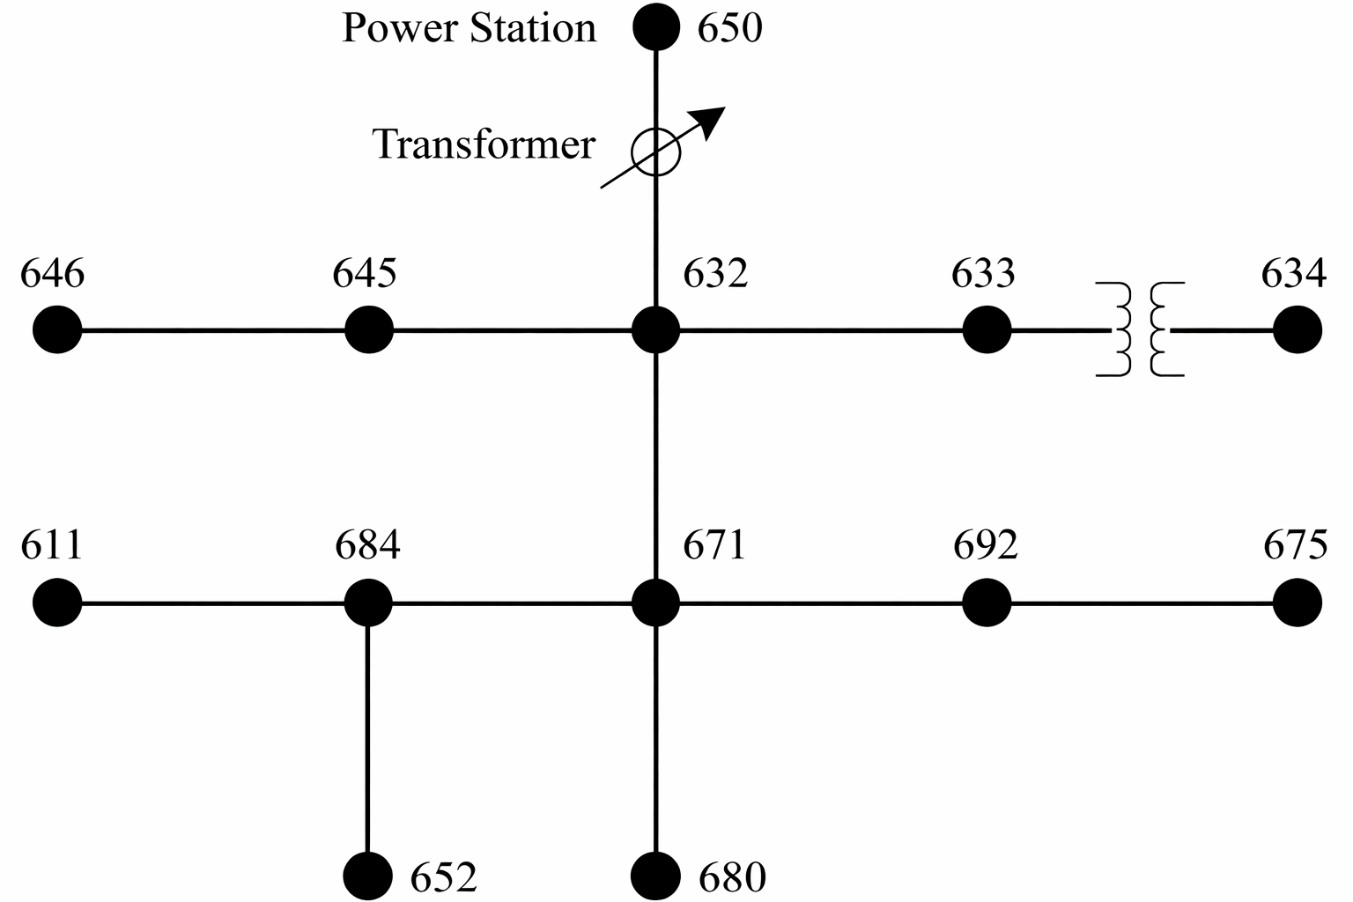
IEEE 13 BUS SYSTEM DIAGRAM

Slide 8
LOAD ALTERATION AND COMPENSATION IN EXISTING SYSTEM:
The IEEE 13‑node test feeder, developed by IEEE PES Distribution System Analysis Subcommittee, United States serves as a benchmark for DER integration studies.
LOADS | Bus Connected | Phases | Connection | Voltage (kV) | Active Power (kW) | Reactive Power (kVAR)
Irrigation Pump -motor load | 671.1 | 1 | Wye | 2.4 | 80 | 40
Residential Houses-Fans, lights, AC | 680.1.2.3 | 3 | Wye | 4.16 | 150 | 90
Cooling systems(AC)-Schools | 684.3 | 1 | Wye | 2.4 | 60 | 30
Agro Processing Mill | 692.1.2.3 | 3 | Wye | 4.16 | 120 | 70
CAPACITORS | Bus Connected | Phases | Voltage (kV) | Reactive Power (kVAR)
Cap3 | 671.1 | 1 | 2.4 | 40
Cap4 | 680 | 3 | 4.16 | 100
Cap5 | 684.3 | 1 | 2.4 | 30
Cap6 | 692 | 3 | 4.16 | 80
Agricultural Pumps
Permanently installed for irrigation, causes continuous motor load to the feeder.
Agro Mills
Addition industrial loads draw high power and increase feeder demand.
Residential ACs & Fans
Newly connected cooling loads raise peak and base demand.
School Loads
Regular daytime loads (fans, lights, ACs) adds to feeder loading.
As a result more current absorption will be take place.
To balance the current losses compensation capacitors were added at subsequent places

Slide 9
BUS DATA
Standard IEEE 13 Bus Data used for calculation :-
1.VOLTAGE REGULATORS :
REGULATOR | TRANSFORMER | PHASE | FROM BUS | TO BUS | KV | KVA | VREG | PT RATIO | CT (A) | R | X
Reg1 | Reg1 | 1 | 650.1 | RG60.1 | 2.4 | 1666 | 122 | 20 | 700 | 3 | 9
Reg2 | Reg2 | 2 | 650.2 | RG60.2 | 2.4 | 1666 | 122 | 20 | 700 | 3 | 9
Reg3 | Reg3 | 3 | 650.3 | RG60.3 | 2.4 | 1666 | 122 | 20 | 700 | 3 | 9
2.TRANSFORMERS :
NAME | PHASES | WINDINGS | BUS1 | BUS2 | CONN1 | CONN2 | KV1 | KV2 | KVA | %R | XHL
Sub | 3 | 2 | SourceBus | 650 | Delta | Wye | 115 | 4.16 | 5000 | 5 | 8
XFM1 | 3 | 2 | 633 | 634 | Wye | Wye | 4.16 | 0.48 | 500 | 0.55 | 2
3.CAPACITORS :
NAME | BUS | PHASES | KV | KVAR
Cap1 | 675 | 3 | 4.16 | 600
Cap2 | 611.3 | 1 | 2.4 | 100

Slide 10
BUS DATA
4.SPOT LOAD :
LOAD | BUS | PHASES | CONN | KV | KW | KVAR
671 | 671.1.2.3 | 3 | Delta | 4.16 | 1155 | 660
634a | 634.1 | 1 | Wye | 0.277 | 160 | 110
634b | 634.2 | 1 | Wye | 0.277 | 120 | 90
634c | 634.3 | 1 | Wye | 0.277 | 120 | 90
645 | 645.2 | 1 | Wye | 2.4 | 170 | 125
646 | 646.2.3 | 1 | Delta | 4.16 | 230 | 132
692 | 692.3.1 | 1 | Delta | 4.16 | 170 | 151
675a | 675.1 | 1 | Wye | 2.4 | 485 | 190
675b | 675.2 | 1 | Wye | 2.4 | 68 | 60
675c | 675.3 | 1 | Wye | 2.4 | 290 | 212
611 | 611.3 | 1 | Wye | 2.4 | 170 | 80
652 | 652.1 | 1 | Wye | 2.4 | 128 | 86
5.SWITCH DATA
NAME | FROM BUS | TO BUS | PHASES | TYPE | R | X
671692 | 671 | 692 | 3 | Switch | 1e-4 | 0

Slide 11
BUS DATA
6.SOURCE DATA
PARAMETER | VALUE
Base Voltage (KV) | 115
PU Voltage | 1.000
Phase Angle | 30°
MVAsc3 | 20000
MVAsc1 | 21000
The Short circuit MVASc is calculated using,
Z_ohms = (kV_base)^2 / MVA_sc
Here the value of the short circuit (MVASc) is set very high -> Impedance will be lowered resulting in lower voltage drop for large current intake by the heavy loads
For ex:,- 1155 KW and 660 KVAR connected to the bus 671.

Slide 12
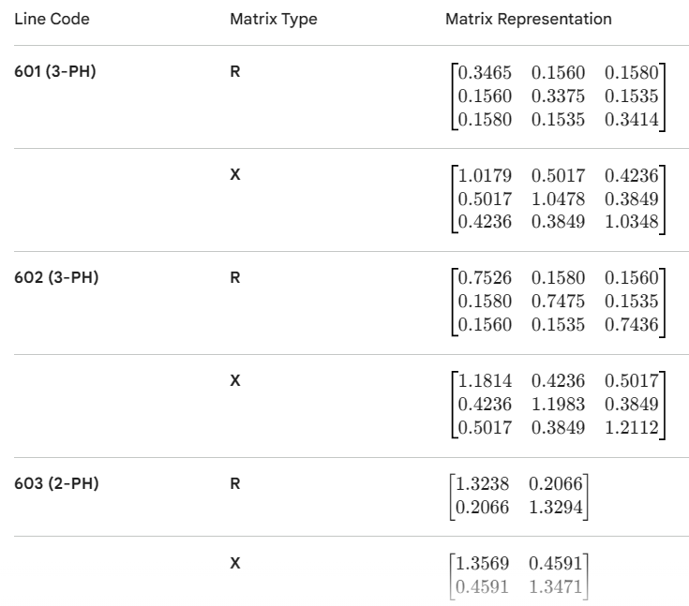
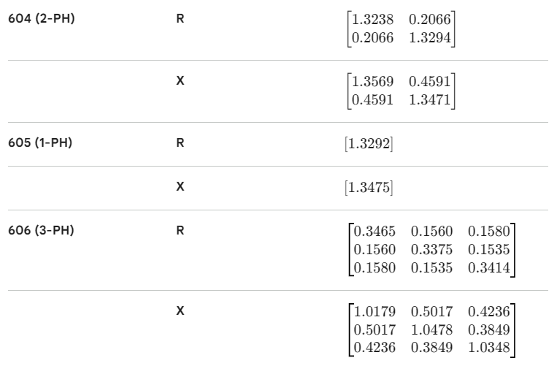
BUS DATA
8.LINE CONFIGURATION DATA:

Slide 13
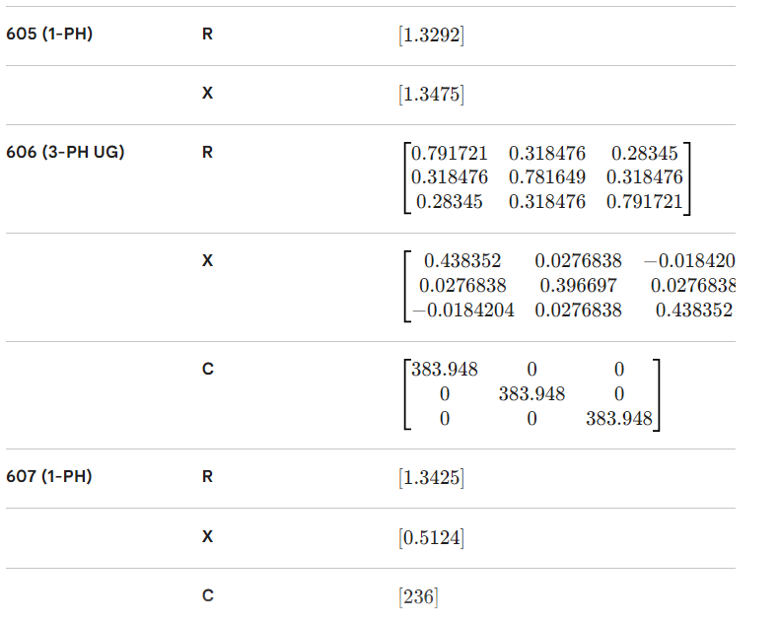
BUS DATA
8.LINE CONFIGURATION DATA:

Slide 14
VOLTAGE VARIATION (LINE 632-671) ON A DAY
AFTER ADDITION OF NEW LOADS WITH CAPACITOR COMPENSATION
BEFORE ADDITION OF NEW LOADS WITH CAPACITOR COMPENSATION

Slide 15
BUS VOLTAGE PROFILE
BEFORE LOAD ADDITION AND COMPENSATION
BUS | NODE1 | MAGNITUDE1 | PU1 | NODE2 | MAGNITUDE2 | PU2 | NODE3 | MAGNITUDE3 | PU3
SOURCEBUS | 1 | 66345.3 | 0.99925 | 2 | 66358.2 | 0.99944 | 3 | 66340.8 | 0.99918
650 | 1 | 2374.75 | 0.98875 | 2 | 2381.65 | 0.99162 | 3 | 2375.69 | 0.98914
RG60 | 1 | 2369.58 | 0.98659 | 2 | 2377.83 | 0.99003 | 3 | 2370.65 | 0.98704
633 | 1 | 2293.49 | 0.95491 | 2 | 2369.11 | 0.9864 | 3 | 2296.83 | 0.9563
634 | 1 | 259.836 | 0.9376 | 2 | 269.621 | 0.97291 | 3 | 261.22 | 0.94259
671 | 1 | 2246.73 | 0.93545 | 2 | 2397.18 | 0.99809 | 3 | 2246.43 | 0.93532
645 | 2 | 2356.47 | 0.98114 | 3 | 2298.13 | 0.95684 | 0 | 0 | 0
646 | 2 | 2353.52 | 0.97991 | 3 | 2294.63 | 0.95539 | 0 | 0 | 0
692 | 1 | 2246.7 | 0.93543 | 2 | 2397.25 | 0.99811 | 3 | 2246.4 | 0.93531
675 | 1 | 2236.43 | 0.93116 | 2 | 2401.93 | 1.0001 | 3 | 2244.19 | 0.93439
611 | 3 | 2240.92 | 0.93303 | 0 | 0 | 0 | 0 | 0 | 0
652 | 1 | 2233.45 | 0.92991 | 0 | 0 | 0 | 0 | 0 | 0
632 | 1 | 2298.71 | 0.95709 | 2 | 2372.5 | 0.98781 | 3 | 2301.38 | 0.9582
680 | 1 | 2246.73 | 0.93545 | 2 | 2397.18 | 0.99809 | 3 | 2246.43 | 0.93532
684 | 1 | 2243.26 | 0.934 | 3 | 2243.66 | 0.93417 | 0 | 0 | 0

Slide 16
BUS VOLTAGE PROFILE
AFTER LOAD ADDITION AND COMPENSATION
BUS | NODE1 | MAGNITUDE1 | PU1 | NODE2 | MAGNITUDE2 | PU2 | NODE3 | MAGNITUDE3 | PU3
SOURCEBUS | 1 | 66342.8 | 0.99921 | 2 | 66358.6 | 0.99945 | 3 | 66339.4 | 0.99916
650 | 1 | 2371.24 | 0.98728 | 2 | 2379.83 | 0.99086 | 3 | 2372.74 | 0.98791
RG60 | 1 | 2365.38 | 0.98485 | 2 | 2375.66 | 0.98912 | 3 | 2367.11 | 0.98557
633 | 1 | 2287.16 | 0.95228 | 2 | 2371.36 | 0.98733 | 3 | 2287.78 | 0.95254
634 | 1 | 259.12 | 0.93502 | 2 | 269.883 | 0.97386 | 3 | 260.192 | 0.93889
671 | 1 | 2239.53 | 0.93245 | 2 | 2404 | 1.0009 | 3 | 2232.25 | 0.92942
645 | 2 | 2358.72 | 0.98207 | 3 | 2289.04 | 0.95306 | 0 | 0 | 0
646 | 2 | 2355.75 | 0.98084 | 3 | 2285.54 | 0.95161 | 0 | 0 | 0
692 | 1 | 2239.49 | 0.93243 | 2 | 2404.07 | 1.001 | 3 | 2232.22 | 0.9294
675 | 1 | 2229.24 | 0.92816 | 2 | 2408.73 | 1.0029 | 3 | 2230.07 | 0.92851
611 | 3 | 2225.64 | 0.92666 | 0 | 0 | 0 | 0 | 0 | 0
652 | 1 | 2226.78 | 0.92714 | 0 | 0 | 0 | 0 | 0 | 0
680 | 1 | 2239.1 | 0.93227 | 2 | 2404.54 | 1.0012 | 3 | 2232.06 | 0.92934
684 | 1 | 2236.56 | 0.93121 | 3 | 2228.36 | 0.92779 | 0 | 0 | 0
632 | 1 | 2292.37 | 0.95445 | 2 | 2374.74 | 0.98874 | 3 | 2292.3 | 0.95442

Slide 17
BUS POWER LOSSES
BEFORE LOAD ADDITION AND COMPENSATION
Element | kW Losses | % of Power | kvar Losses
Transformer.SUB | 25.420 | 1.09 | 1.021
Transformer.REG1 | 2.102 | 0.25 | 0.264
Transformer.REG2 | 1.064 | 0.17 | 0.135
Transformer.REG3 | 1.913 | 0.23 | 0.241
Transformer.XFM1 | 2.878 | 1.03 | 5.232
Capacitor.CAP1 | 0.000 | 0.00 | -548.051
Capacitor.CAP2 | 0.000 | 0.00 | -87.183
Line.650632 | 26.483 | 1.15 | 85.271
Line.632671 | 16.663 | 0.97 | 53.383
Line.671680 | 0.000 | 0.00 | -0.004
Line.632633 | 0.427 | 0.15 | 0.546
Line.632645 | 1.444 | 0.51 | 1.254
Line.645646 | 0.271 | 0.17 | 0.215
Line.671684 | 0.318 | 0.16 | 0.255
Line.684611 | 0.215 | 0.19 | 0.217
Line.684652 | 0.435 | 0.50 | 0.099
Line.692675 | 2.191 | 0.38 | 1.210
Line.671692 | 0.007 | 0.00 | 0.007
CATEGORY | POWER LOSS (kW)
Line Losses | 48.5
Transformer Losses | 33.4
Total Losses | 81.9
Total Load Power | 2245.9
Loss Percentage | 3.64 %

Slide 18
BUS POWER LOSSES
AFTER LOAD ADDITION AND COMPENSATION
Element | kW Losses | % of Power | kvar Losses
Transformer.SUB | 31.002 | 1.19 | 1.244
Transformer.REG1 | 2.605 | 0.27 | 0.327
Transformer.REG2 | 1.251 | 0.18 | 0.158
Transformer.REG3 | 2.337 | 0.25 | 0.294
Transformer.XFM1 | 2.861 | 1.03 | 5.202
Capacitor.CAP1 | 0.000 | 0.00 | -545.882
Capacitor.CAP2 | 0.000 | 0.00 | -85.998
Capacitor.CAP3 | 0.000 | 0.00 | -34.830
Capacitor.CAP4 | 0.000 | 0.00 | -91.170
Capacitor.CAP5 | 0.000 | 0.00 | -25.862
Capacitor.CAP6 | 0.000 | 0.00 | -72.937
Line.650632 | 32.427 | 1.26 | 104.227
Line.632671 | 21.762 | 1.10 | 69.762
Line.671680 | 0.025 | 0.02 | 0.079
Line.632633 | 0.425 | 0.15 | 0.543
Line.632645 | 1.444 | 0.51 | 1.254
Line.645646 | 0.272 | 0.17 | 0.216
Line.671684 | 0.464 | 0.19 | 0.381
Line.684611 | 0.211 | 0.19 | 0.214
Line.684652 | 0.433 | 0.50 | 0.098
Line.692675 | 2.182 | 0.38 | 1.202
Line.671692 | 0.007 | 0.00 | 0.007
CATEGORY | POWER LOSS (kW)
Line Losses | 59.7
Transformer Losses | 40.1
Total Losses | 99.8
Total Load Power | 2512.5
Loss Percentage | 3.97 %

